Slide 1
Logic Gate Fundamentals Part- 1
Topics to cover:-
Boolean Algebra & Characteristics
Boolean Variable and Constant
Boolean Postulates- OR, AND
Boolean Complements
Boolean Duality Principle
Fundamental Operations of Boolean Algebra
Truth Table
Boolean Theorem

Slide 2
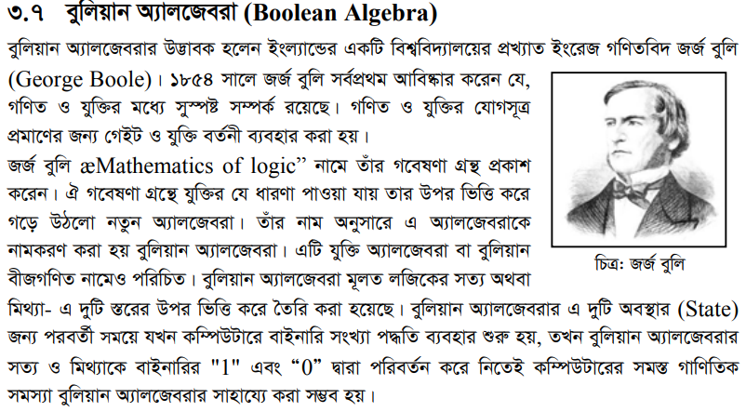

Boolean Algebra
01.

Slide 3
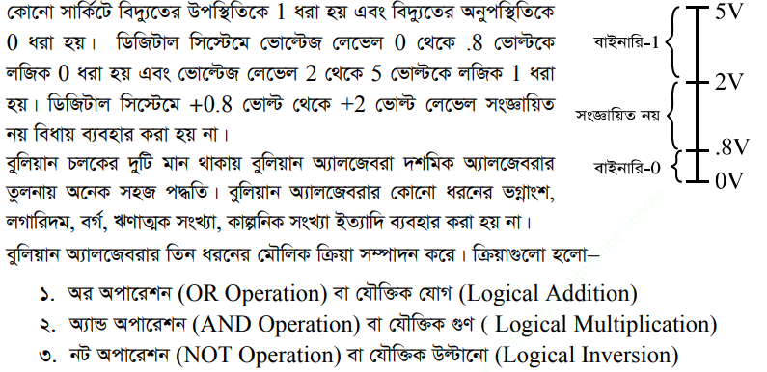

Slide 4
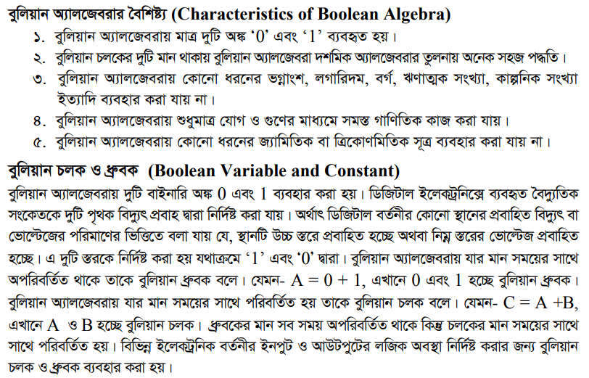
02.

Slide 5
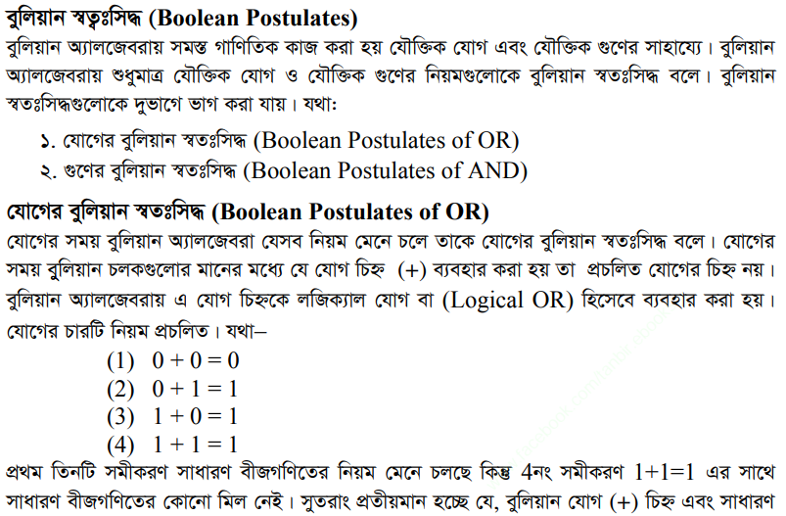

03.

Slide 6
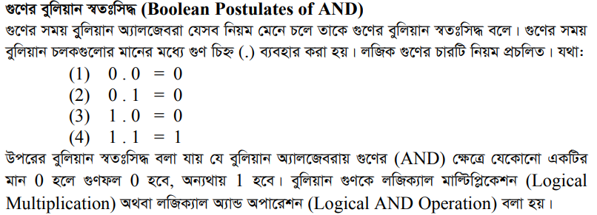
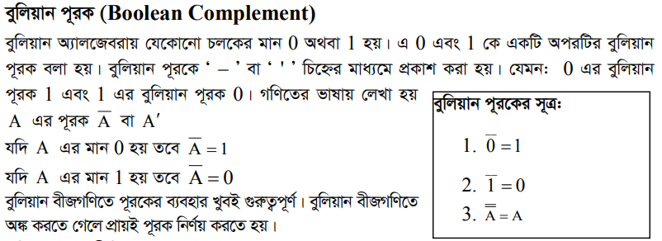
04.

Slide 7
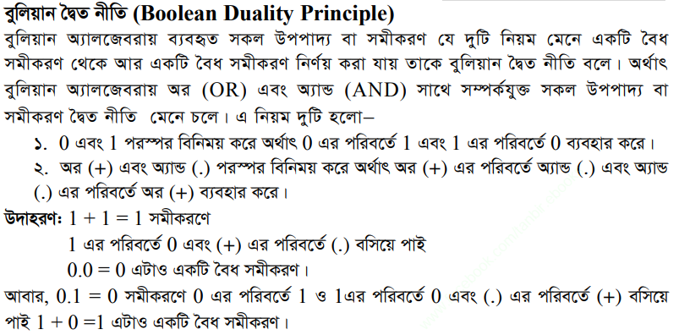
05.

Slide 8
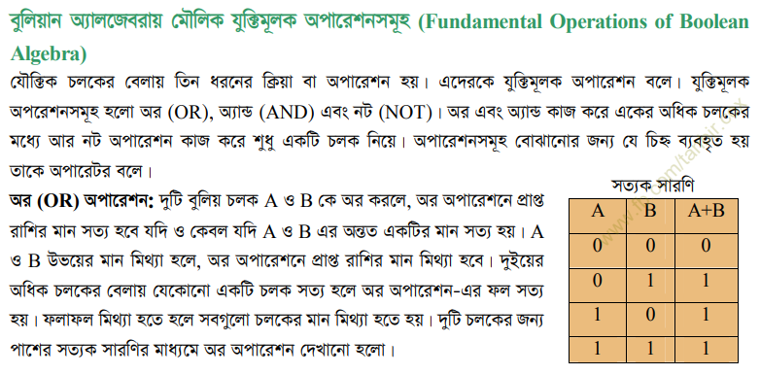

06.

Slide 9
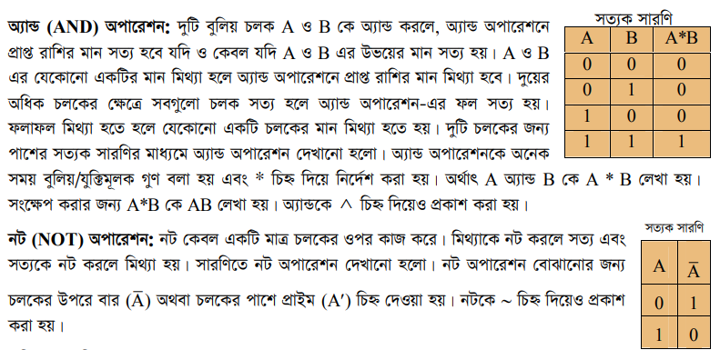

Slide 10
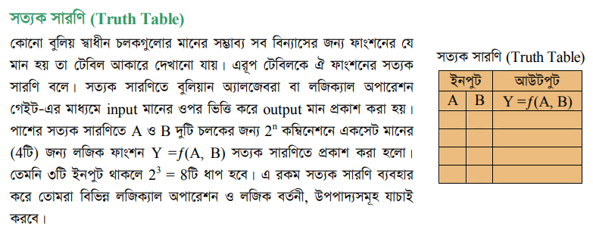
07.

Slide 11
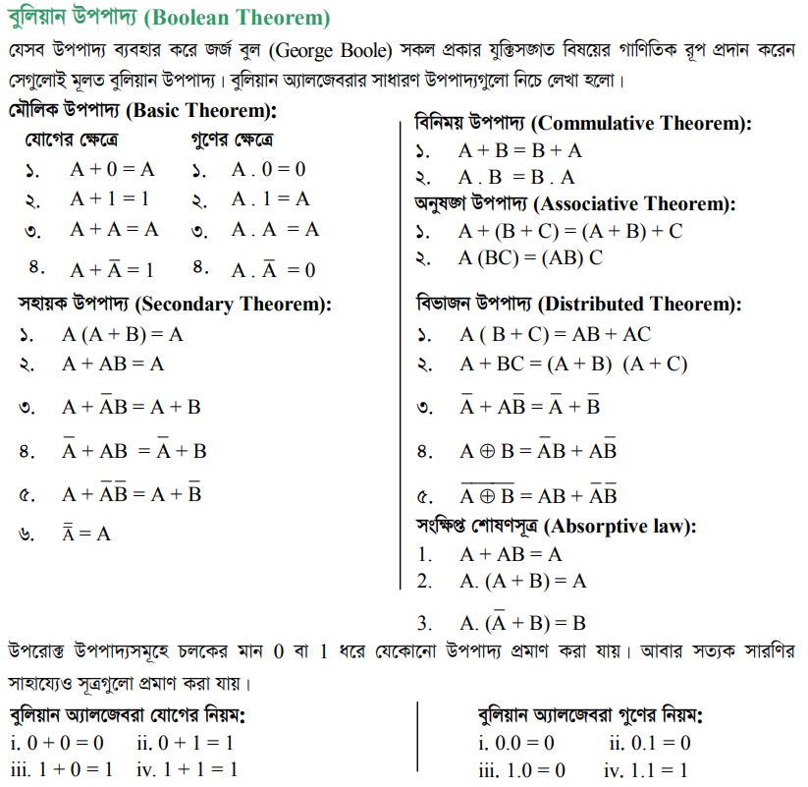
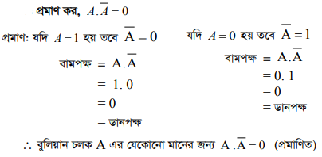
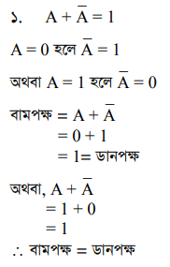
08.
Ex-

Slide 12
